Slide 1
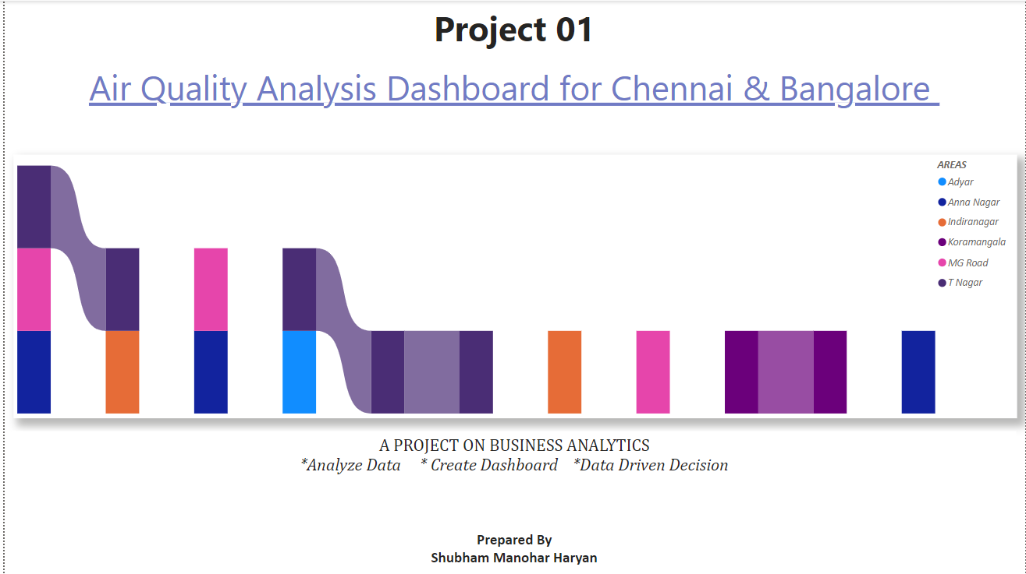

Slide 2
Objective:
To develop a comprehensive Air Quality Analysis Dashboard that utilizes various skills in Business Intelligence, SQL, Excel , Power BI, MS Office Word, MS Office PowerPoint and Python to monitor and analyze air quality data in urban areas.
The dashboard aims to provide actionable insights for policymakers and the public regarding air quality trends, sources of pollution, and health impacts.

Slide 3
Introduction
In today’s modern world, air quality has become a critical concern and it’s directly impacting public health and the environment. To address this critical issue, we aim to develop a complete Air Quality Analysis Dashboard.
This dashboard will serve as a vital tool for monitoring and analyzing air quality data in urban areas, providing users with actionable insights into air quality trends, sources of pollution, and their associated health impacts. By using data analysis techniques and visualization tools, the dashboard will empower policymakers and the public alike, enabling informed decision-making and fostering greater awareness of air quality issues.
(Disclaimer- The information and data presented in the Air Quality Analysis Dashboard are intended for informational and educational purposes only. The dataset and reports used may not represent real-world scenarios. The insights provided are based solely on the given data. All information is intended to demonstrate my capabilities in power BI.)

Slide 4
Data Overview
The dataset organized into for key tables: Locations, Pollutants, AirQuality, and HealthImpact.
Each table provides critical information necessary for understanding air quality trends, pollutant levels, and associated health impacts in urban areas.
Dataset size- The dataset contains 4 tables. Locations- 5 Columns, 5 rows, Pollutants- 3 column 5 rows, AirQuality- 7 columns 16 rows, and HealthImpact- 4 columns 5 rows.
Data include- The data includes the cities of Chennai and Bangalore, along with their respective areas and latitude/longitude.

Slide 5
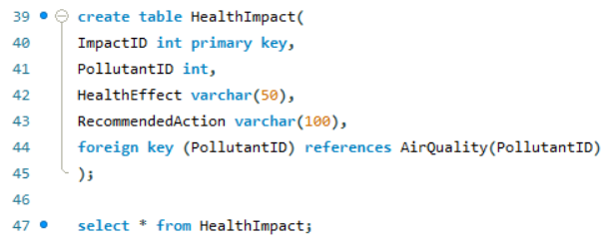
Database Creation
.
Created a SQL database to organize the air quality data. This include tables for AirQuality, Locations, Pollutants, and HealthImpact.

Slide 6
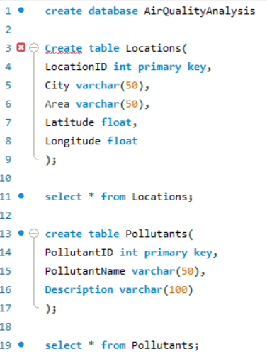
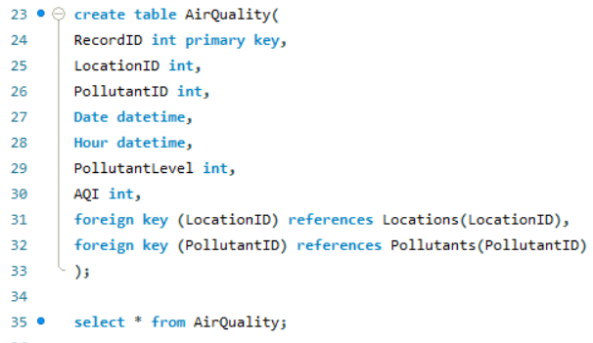

Slide 7
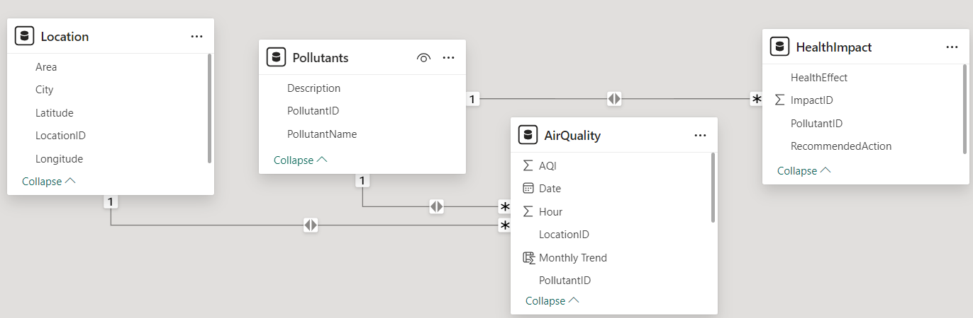
Data Modelling
Establish relationships between tables linking AirQuality to Locations and Pollutants also have created Pollutants to HealthImpact.

Slide 8
Data Visualization
Data Visualization report display below charts for the final interactive dashboard view-
Slicers
KPI
Funnel
Map
Pie chart
Donut chart
Line chart
Column chart
Treemap
Waterfall chart

Slide 9
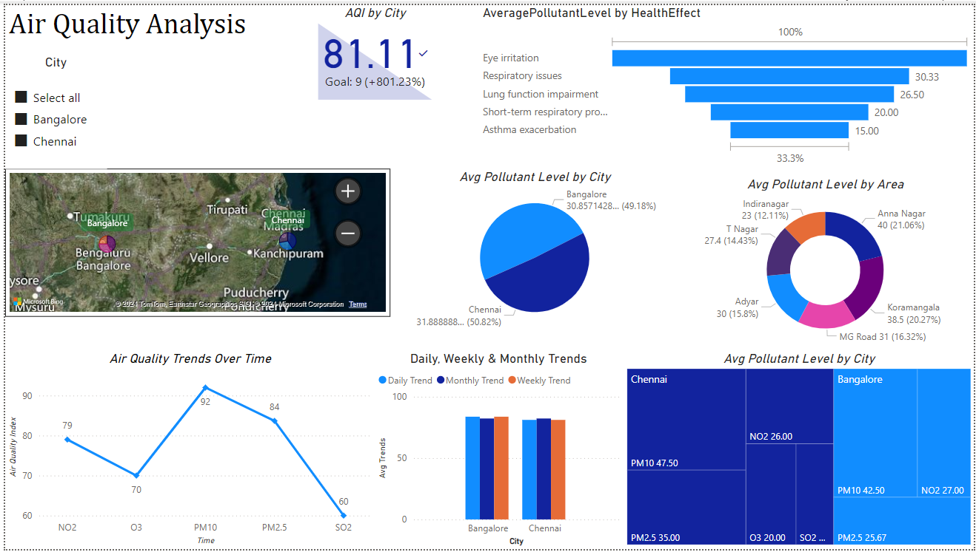
Analysis
The Air Quality Analysis Dashboard leverages the structured dataset to provide comprehensive insights into air quality trends and their implications. Below is a detailed analysis based on the available data from the tables: Locations, Pollutants, AirQuality, and HealthImpact.

Slide 10
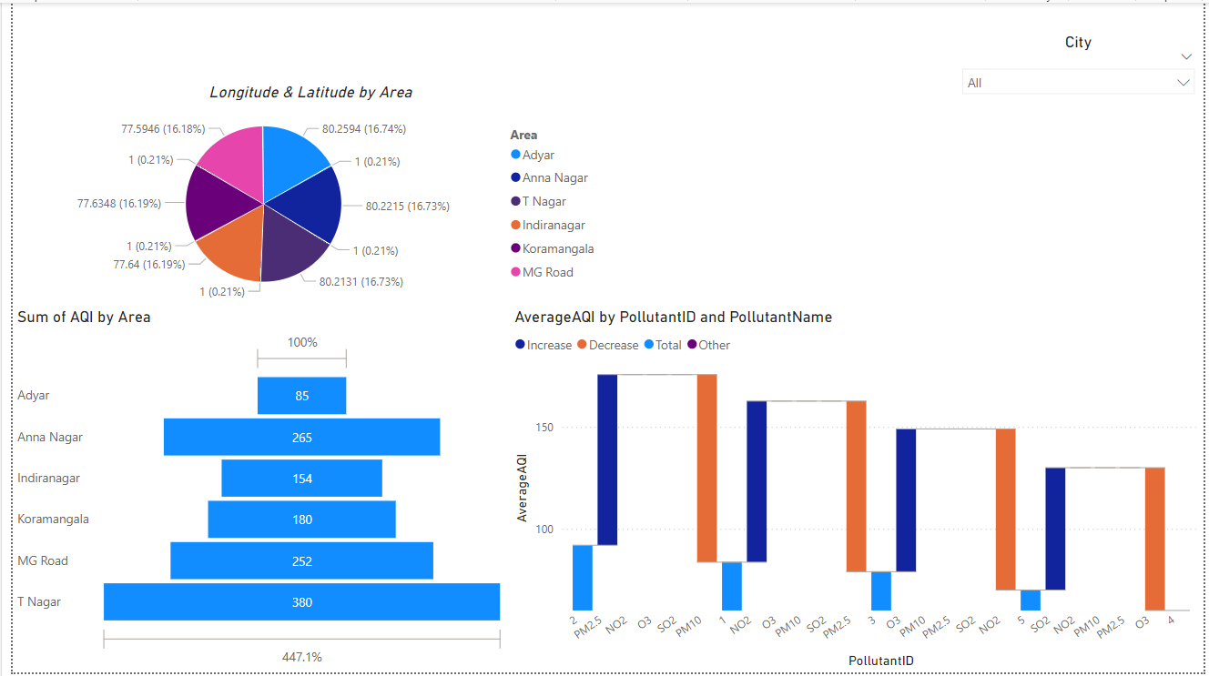

Slide 11
Insights
Air Quality Trends: The line chart will provide insights into whether air quality is improving or deteriorating over time, reflecting the effectiveness of local regulations or pollution control measures. According to the dashboard, the AQI for Bangalore is 83.71, while for Chennai it is 81.11.
City Comparisons: The bar chart will help identify which city has the highest levels of specific pollutants, guiding local authorities in prioritizing air quality initiatives. According to the dashboard, both PM10 and PM2.5 pollutants have high AQI levels. In Bangalore, the PM10 pollutant is particularly elevated, while in Chennai, both PM10 and PM2.5 levels are high.
Health Risk Awareness: The dashboard can educate users about the health effects of various pollutants, promoting proactive health measures, such as reducing outdoor activities or using air purifiers during high pollution days.
Actionable Recommendations: Pollutant levels with recommended actions from the health impact table, users can receive advice based on current air quality, enhancing community awareness and safety.
For the PM10 pollutant, the health effects include eye irritation and respiratory issues, both of which can be significant concerns. The recommendations to mitigate these effects include using air purifiers indoors to reduce eye irritation and limiting outdoor activities during high pollution levels to address respiratory issues.

Slide 12
Thank You
Share your valuable feedback
Email- haryanshubham57@gmail.com

